Slide 1
Instructor Assessment System
CSC 869: Data Mining Term Project, Spring 2015
Pratik Jaiswal

Slide 2
Presentation Outline
Problem being addressed
Previous work
Dataset Information
Classification and results
Effects of data size, attribute reduction
UI Applications
Lessons Learned
Summary

Slide 3
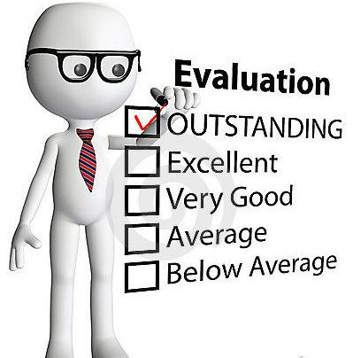
Problem
Student opinion about their instructors
Helps education managers in decisions
Huge amount of traffic on rating websites
- Eg. ratemyprofessors, profeval, etc.

Slide 4
Previous work
Wilson (1998) – good graders are evaluated well
Felton (2004) - overall quality as a function of easiness
Otto (2005) - addressed a number of issues related to bias, availability of ratings and purpose of ratings

Slide 5
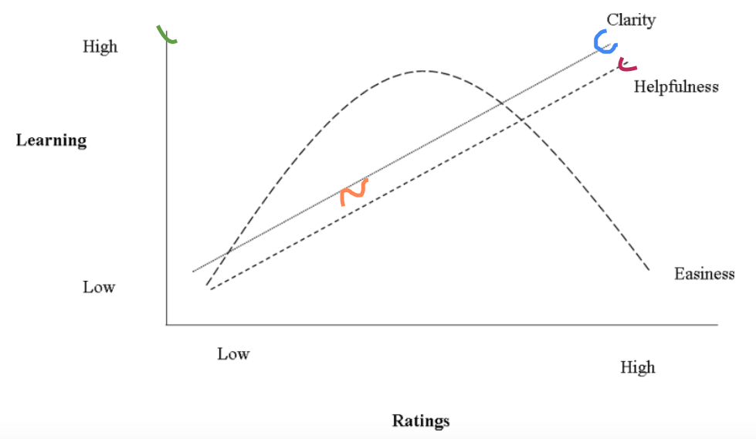
Dataset
Format:
{ Professor ABC, XYZ College
Helpfulness: 5.0: Easiness: 4.6
Overall quality: 5.0 }
Follows Halo effect
Easiness, clarity, and
helpfulness are interrelated

Slide 6
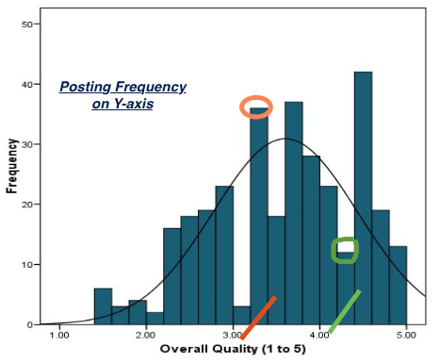
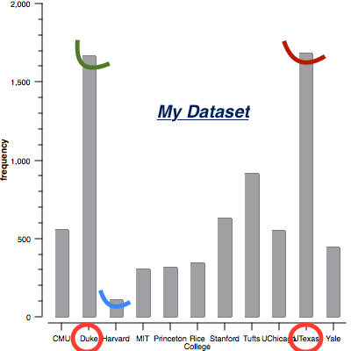
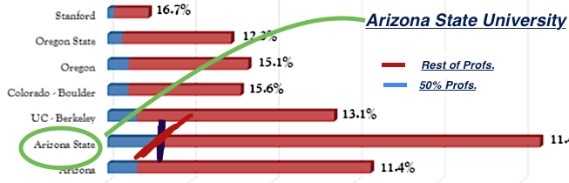
OBSERVATIONS FROM DATASET

Slide 7
Classification and Results
Accuracy of self written Naïve Bayesian Classifier = 81.06 % as compared to that of Weka’s accuracy of 89.11%
Insights from decision tree classifier –
eg. IF(Evaluation score = Excellent) AND (Teaching_experience = FALSE means is low) THEN (Acceptation is Yes, means instructor will be promoted further)
Universities: Duke and Texas(Dallas) > Stanford & Harvard

Slide 8
Classification and Results(contd.)
Overall analysis with tree – performance degrades
Regression analysis opposes developer’s assumption
Lets move on to the UI applications…

Slide 9
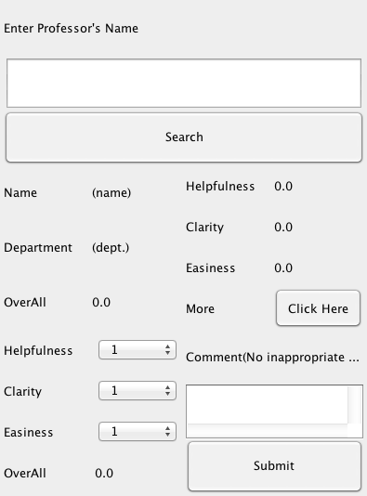
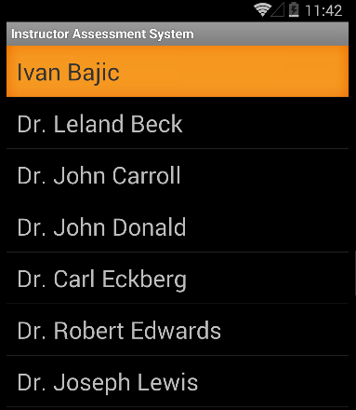
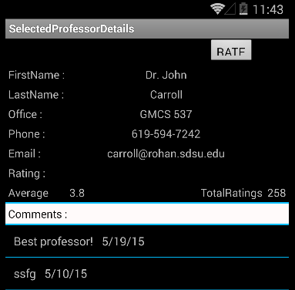
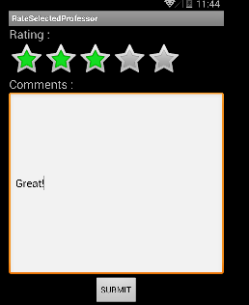
PC APPLICATION .JAR
ANDROID APPLICATION
(app)

Slide 10

Lessons Learned
Victim of mistakes - ‘Lack of proper data’ (initial stages, later corrected) and ‘Believe the best model’ (decision tree → Naive Bayes)
UI applications can be effective:
SFSU
De Anza
UFL
0 1000 2000 3000 4000
Neglecting an attribute – major difference
Assigning weights can lead to validity

Slide 11
Summary
Problem
Effective way to analyze instructor ratings
Interesting observations from data
Application of classifiers
My research paper at: https://github.com/jpratik21/Data-Mining-Term-Project-CSC-869/blob/master/869%20-%20Term%20Project%20Paper.pdf (copy-paste if necessary)
Future work - incorporating instructor experience
- application expansion (statistics)
- make ratings robust, apply filters
Thank you!

